Slide 1

GROUP 2
OLIST STORE ANALYSIS
Uncovering Customer Insights and Sales Trends
PRESENTED BY:
Atharva Mariwar
Avantika Paranjape
Omkar Bhoir
Shrutika Kudale
Guided By: Dipti Sinha

Slide 2

In this Presentation
Overview
Introduction
Project Analysis
Data Preparation
KPI’s
Dashboard
Conclusion
Recommendation

Slide 3

INTRODUCTION
This comprehensive analysis delves into the vast Olist store dataset, a treasure trove of information about customer behavior and sales trends on the Brazilian e-commerce platform. The dataset, containing over 100,000 orders from 2016 to 2018, offers valuable insights into customer demographics, product preferences, and payment patterns. This presentation provides a detailed exploration of the key findings and their implications for optimizing business strategies and enhancing customer satisfaction.

Slide 4
Dataset Overview and Components
Order Items
Detailed information about individual items included in each order, encompassing product ID, quantity, price, and other relevant attributes.
Orders
General information about each order, including customer ID, order date, order status, delivery details, and payment method.
Payments
Comprehensive data on payment transactions associated with. each order, encompassing payment method, payment value, and installment details.
Reviews
Customer feedback on their purchase experience, including review score, comments, and timestamps, providing insights into customer satisfaction levels.

Slide 5




PROJECT ANALYSIS
RAW DATA
CLEAN DATA
ETL
Process
Optimization
Database
Normalisation
Analytics
Insights
Data storage through multiple CSV files
Reduce Data Storage
Create a normalized relation as a central data to collect files in
a workbook
Conduct Data manipulation and data cleaning with excel and
mysql
Generate Analytical insights through an interactive dashboard via power BI, tableau
Inefficient information
Create efficient query
and analysis
Lack of analytics insights to make business decisions
Empower data driven decision making capabilities

Slide 6
Data Preparation and Analysis Tools
1
2
3
4
Step
Step
Step
Step
Data Cleaning
Data Transformation
Statistical Analysis.
Visualization
Employing statistical methods to identify patterns, trends, and relationships within the data, including descriptive statistics, hypothesis testing, and regression analysis.
Utilizing Power BI to create dashboards and visualizations that effectively communicate insights, trends, and patterns to stakeholders.
Addressing missing values, inconsistencies, and duplicates to ensure data quality and accuracy.
Converting data into a suitable format for analysis, including data aggregation, feature engineering, and normalization.
.

Slide 7
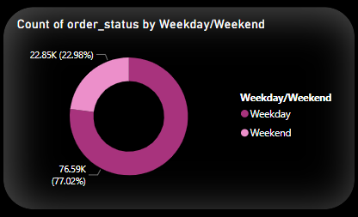
Weekday vs Weekend Sales and Payment Statistics
Analyzing sales trends based on the day of the week to identify patterns in customer buying behavior and payment preferences.

Slide 8
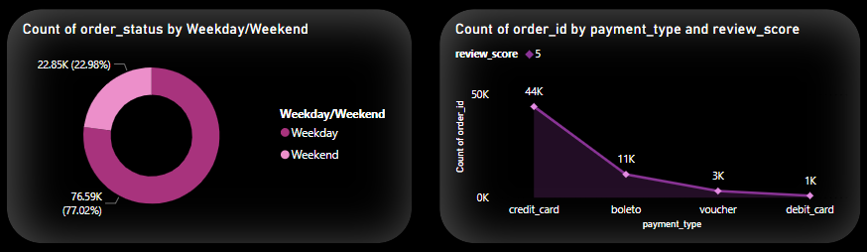
Customer Satisfaction
Evaluating customer satisfaction by analyzing the number of orders with 5-star review scores and credit card payments, identifying repeat
buyers and satisfied customers.

Slide 9
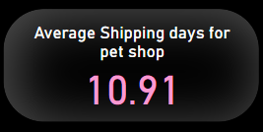
Delivery Performance for Pet Shops
Analyzing the average delivery time for orders from pet shops to identify areas for improvement in logistics and delivery efficiency.

Slide 10
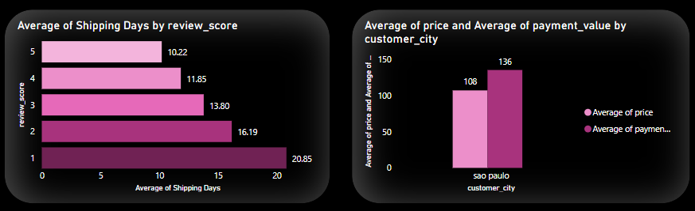
Spending Patterns of São Paulo Customers
Evaluating customer satisfaction by analyzing the number of orders with 5-star review scores and credit card payments, identifying repeat
buyers and satisfied customers.

Slide 11
Shipping Days vs Review score
Analyzing the average delivery time for orders from pet shops to identify areas for improvement in logistics and delivery efficiency.

Slide 12

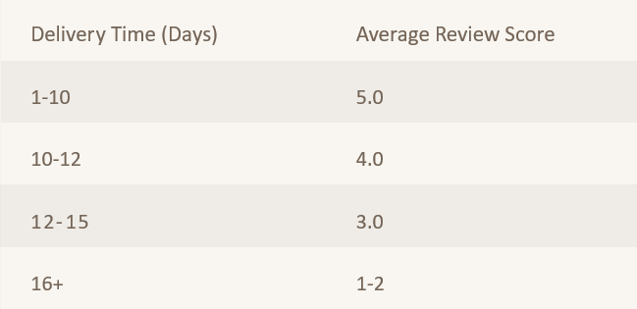
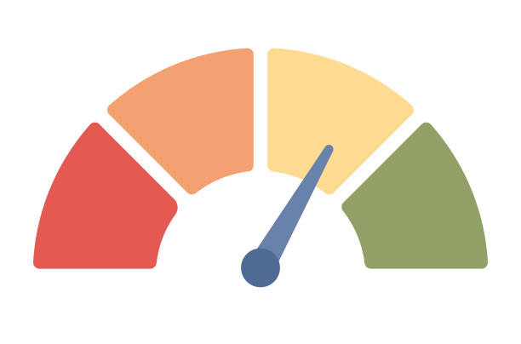
Impact of Delivery Time on Customer Reviews

Slide 13
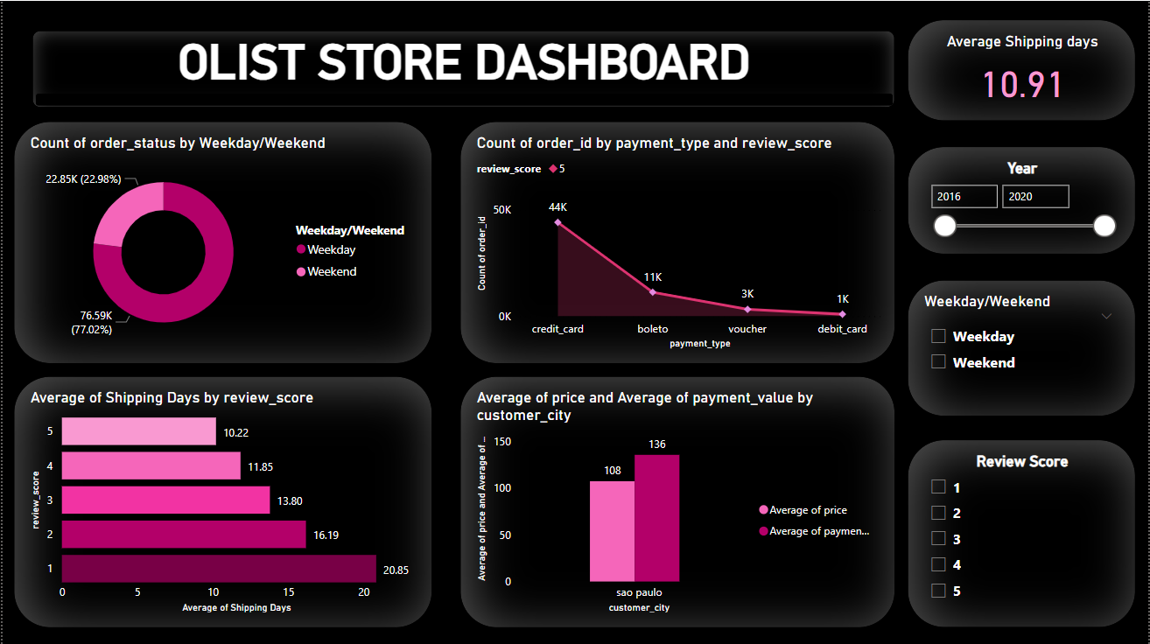

Slide 14
CONCLUSION
Purchase Time: Weekdays are preferred over weekends
Payment Type: Highest no. of payments are done using credit card
Review Score & Delivery days: Quick delivery got better reviews
Regional Influence: Eastern region along with sao paulo city has maximum customer engagement
Maximum orders: March to August

Slide 15
Recommendations
•Targeted Marketing Campaigns: Implement marketing strategies that focus on peak shopping times, particularly weekends, to maximize revenue from credit card transactions.
•Enhance Customer Retention: Develop loyalty programs or incentives for repeat customers to encourage further purchases. This could include discounts or exclusive offers for returning customers.
•Optimize Product Offerings: Focus on promoting high-performing product categories while analyzing underperforming categories for potential improvements or phased removal.
•Reduce Order Cancellations: Investigate the reasons behind order cancellations to address any underlying issues. This could involve improving product availability, enhancing customer service, or refining the checkout process.
•Data-Driven Decision Making: Utilize the insights gained from the data analysis to inform business strategies, including pricing adjustments, inventory management, and customer engagement tactics.

